Slide 1
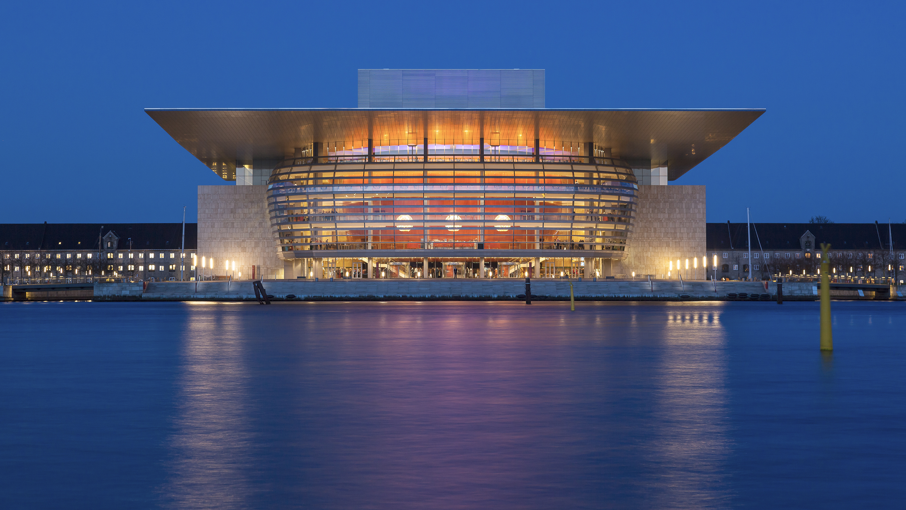
Opening a new restaurant
Ansu Turay 2021
Using location data to help determine candidate areas

Slide 2
Agenda
* Provide a list of established West African Restaurants (WAR) within London
* Distinguish WAR from other restaurants on folium map
*Provide a list of 15 candidate areas for opening a new WAR

Slide 3
Background

Slide 4
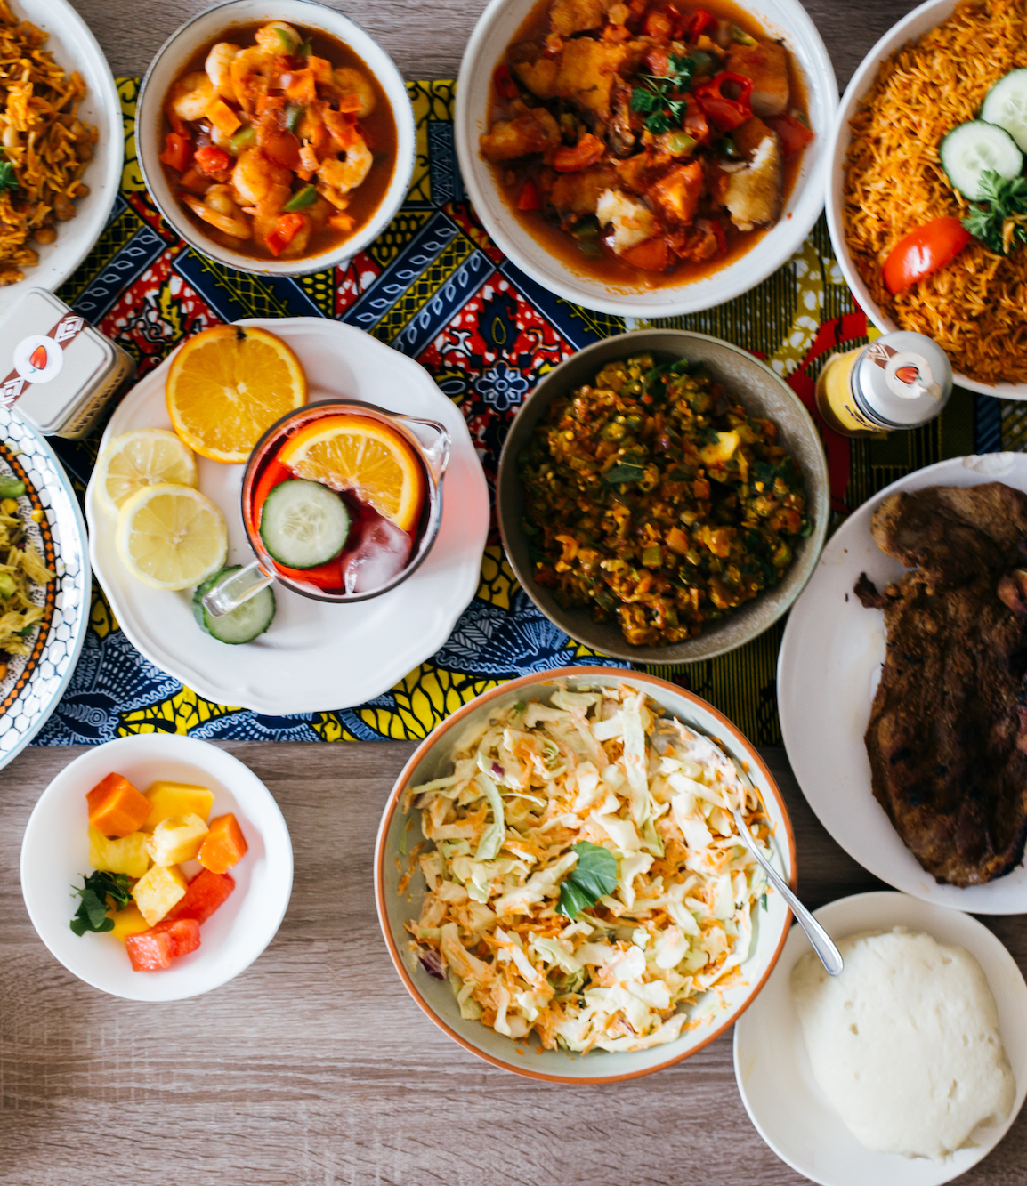
Background
Based on data retrieved from the London datastore - the population of migrants since 1821 has steadily increased.
Cultural integration via intermarriages, friendships built within the workforce or academia etc has led to positive adaptations of social norms. This is evident in food and music.
Caption

Slide 5
Data acquisition and cleaning

Slide 6
Data acquisition and cleaning
Ansu turay 2021
Webscraped Yelp, Tripadvisor and Zomato using Webgrinder
All metadata fields such as review, website links and cuisine types was removed.
Fields retained: Name, Address, Longitude and Latitude
Remaining data was taken from FourSquare
2688 restaurants in total recovered from in and around London
Websites | African Restaurants Scraped
Zomato | 235
FourSquare | 29
Yelp | 227
Tripadvisor | 158

Slide 7
7%
Restaurants in London are African

Slide 8
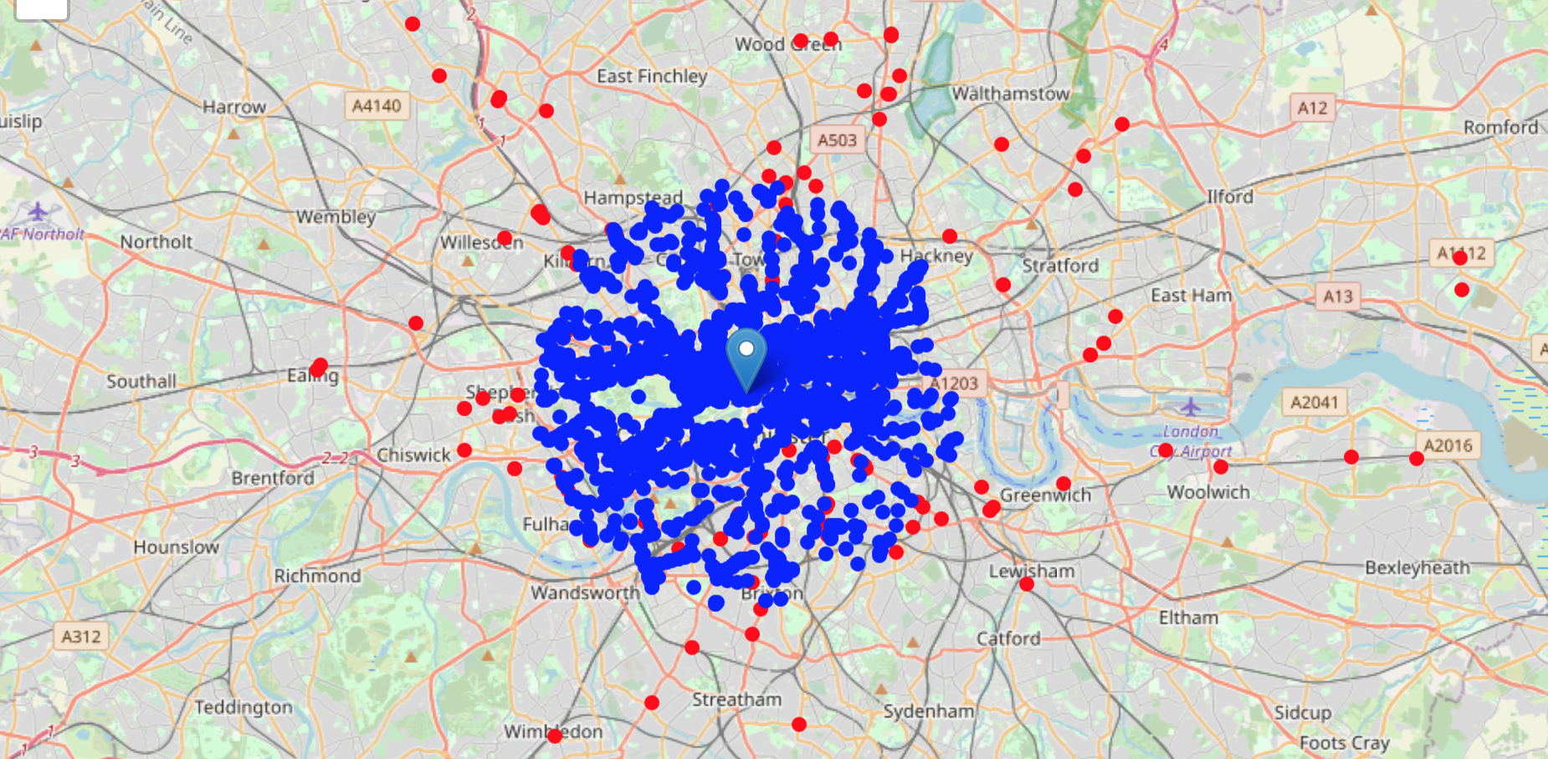
Fig.1 - A plot of all 2688 restaurants. The blue dots represents non African Restaurants and the red dots represents African restaurants in and outside the 6km radius from the center of London.

Slide 9
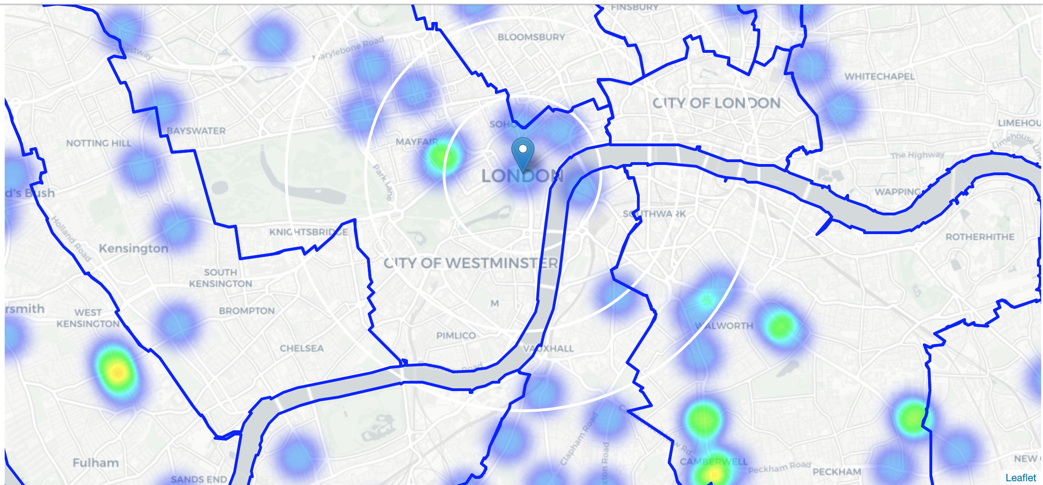
Fig.2 - Heat map of only African restaurant density in London
Notes:
Based on this, the focus was stirred towards analyzing areas south-east and east of London. Therefore the central area of interest was reduced to have a radius of 2.5km. This places our location candidates mostly in boroughs Walworth and City of London (another potentially interesting borough is Wandsworth with large low restaurant density south-west from city center, however this borough is less interesting to stakeholders as it's mostly residential, less popular with tourists and less africans live here).

Slide 10
New Restaurant locations

Slide 11
Restaurants near
candidate areas
ansu turay 2021
Latitude | Longitude | X | Y | Restaurants nearby | Distance to an African restaurant
51.472453 | -0.083196 | -544764 | 5.81E+10 | 4 | 1050
51.472636 | -0.081806 | -544664 | 5.81E+10 | 4 | 1113
51.472198 | -0.091095 | -545314 | 5.81E+10 | 18 | 760
51.472381 | -0.089705 | -545214 | 5.81E+10 | 13 | 777
Table.2 - location data of restaurants that fall outside the scope. Locations with no more than two restaurants nearby was 1245. Locations with no African restaurants within 400m was 2060. And locations with both conditions met was 1104.

Slide 12
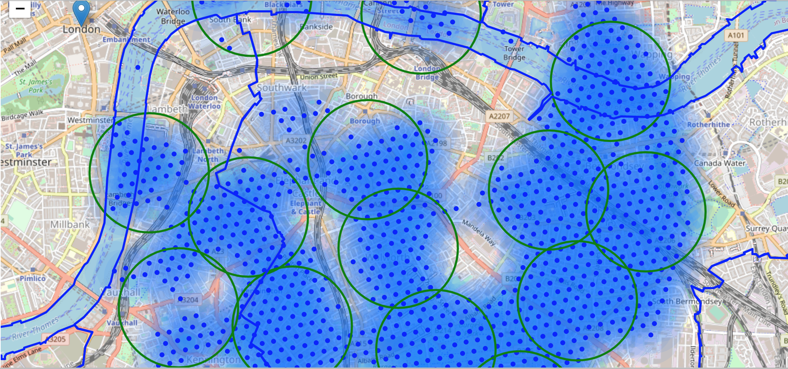

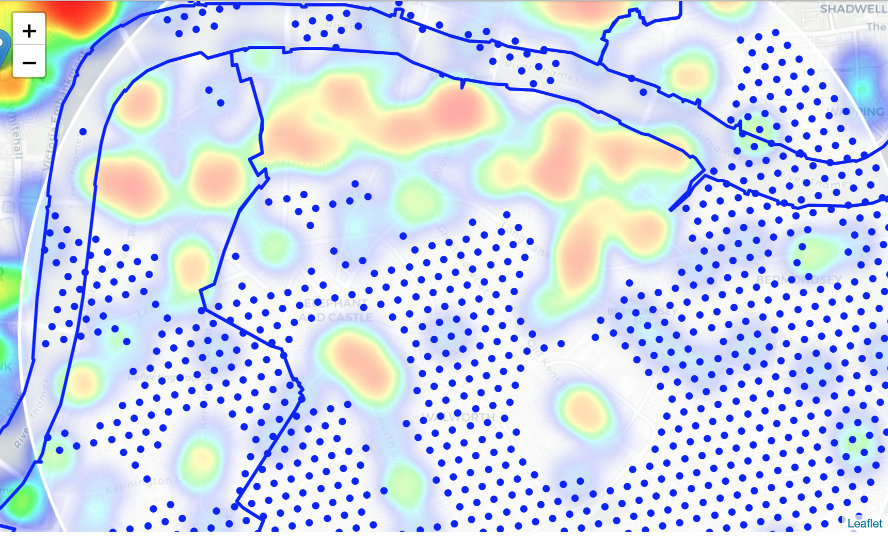
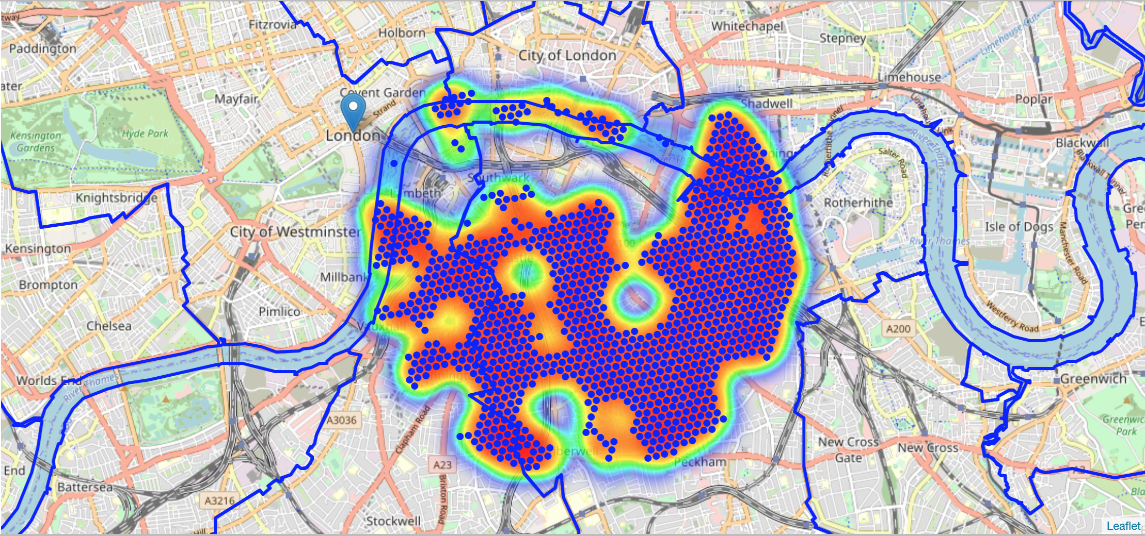
Caption
Fig.3 -clusters represent groupings of most of the candidate locations
Fig.4 & 5 - indication of zones with low number of restaurants in vicinity, and *no* african restaurants at all nearby

Slide 13
Conclusion and future directions

Slide 14
Conclusion and future directions
Ansu turay 2021
Clustering was performed in order to create major zones of interest.
15 candidate addresses were produced as consequence.
The final decision on the optimal restaurant location will be made by stakeholders based on specific characteristics of neighborhoods
The limitation we found whilst conducting our analysis was that we were only able to take in account restaurants that had registered with one of the known providers.
The distance from the nearest African restaurant to the center of one of the candidate areas is based on the data taken from Foursquare (Table.2)

